Slide 1
2017 Global Azure Bootcamp
April 22 2017
Austin TX

Slide 2
Big Data in Azure
Shawn Weisfeld
Sr. Technical Evangelist
Microsoft

Slide 3
Session Objective
This session will provide an overview of the different big data services available in Azure. We will discuss how they can be used together to provide a complete big data workflow for both human-born and machine-born data.

Slide 4








About Me
Shawn Weisfeld
Sr. Technical Evangelist
Microsoft – US Developer Experience
sweisfel@microsoft.com
Austin, TX

Slide 5
Are you an ISV looking to utilize the cloud?
An ISV is a company that sells software or services powered by software.
My team wants to help you on your cloud journey!
Work with an Azure Architect to provide guidance on your technical journey to the cloud.
Work with a Business Evangelist to access Microsoft resources to help get exposure for your solution and bring your solution to market.
For more information email
USmicrosoftISVteam@microsoft.com
Watch recorded & live webcasts
http://www.buildandscaleyourcloudapp.com

Slide 6


Watch User Group presentations for FREE online! We now have over 590 presentations online
Miss a User Group meeting?
Forget something that you learned?
Want to see content from a User Group not in your area?
Want to share with a buddy?
Presentations from the thought leaders on the topics you care about including:
Agile
Azure
C#
Entity Framework
HTML5
MVC
SQL
jQuery
and Much More!
We know you cannot make it to every session,
that is why we post them online for you!
New Content added all the time!
For new content announcements
@UserGroupTV
http://www.UserGroup.tv

Slide 7
Tools

Slide 8












Ingestion
Store
Preparation
Visualization
Storage
Data Lake
Analytics
HDInsight
Hadoop/Spark
Data Factory
HDInsight
Sqoop
Power BI Pro
Power BI Embedded
SQL Database
SQL Data
Warehouse
Analysis
Services
Event Hub
Stream
Analytics
HDInsight
Apache Kafka
Data Lake
Store
Machine
Learning
HDInsight
Apache Storm

Slide 9
What about?
SQL Server
SSIS
Tableau
Oracle
SSRS
SAP Business Objects
MySQL
(your favorite tool here)
Qlik

Slide 10
Patterns

Slide 11
Human-Born Pattern
Examples: orders, sales, financial, customers, marketing
Modeling: Dimensional models (e.g. Kimball)
Queries: Star joins with grouping and aggregation
Loading: Periodic incremental load batches

Slide 12
Human-Born Pattern
DW HA/DR
Data Marts
EDW Loading
MPP Data Warehouse
Data Warehouse
MPP Data Warehouse
Transactional Data Sources
(e.g. ERP systems)
ETL and ELT
Staging
MPP Data Warehouse
SQL DW, SQL DB
Data Warehouse
Dynamics, SAP, Siebel, …
Hadoop, HDI, ADF, SSIS, DL Analytics ,…
AZ Storage, DL Store
SQL DW
SQL DW, SQL DB
Caching
& Security
Report Execution & Orchestration
Semantic Modelling
SSAS, AAS
SSAS, AAS
SSRS
End User Consumption
PBI, Tableau, Qlik, Excel,…
BI & Dashboarding

Slide 13
Machine-Born Pattern
Examples: device telemetry, log records, IoT data
Modeling: Oftentimes de-normalized
Queries: Data ranges combined with string and pattern search
Loading: Ideally continuous loads

Slide 14
Machine-Born Pattern
Hot path (near real time processing)
Virtuous cycle
Continuous Processing
Stream Analytics,…
BI & Dashboarding
Data Sources
(e.g. sensors, devices, telemetry)
Cloud Data Ingress Hub
End User Consumption
Feedback Loop
PBI, Tableau, Qlik, Excel,…
IoT Hub, Event Hub, …
AML, R, ACS, …
MPP Data Warehouse
Caching
& Security
Report Execution & Orchestration
Semantic Modelling
Data Lake
MPP Data Warehouse
MPP Data Warehouse
ADL, HDI
SQL DW
SSAS, AAS
SSAS, AAS
SSRS
Continuous Load
Cold path (batch processing)
DW HA/DR

Slide 15
Wrap up

Slide 16
Call to Action
Play with these services in Azure
Let us know what you think – http://feedback.azure.com
Evaluate workloads that you have that this would help with

Slide 17
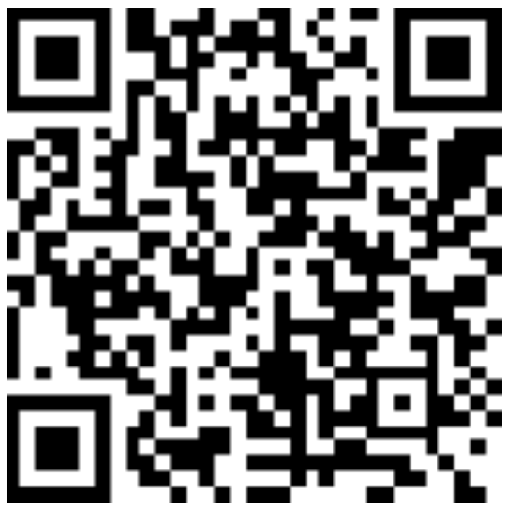
Thank you! Your Feedback is Important
Rate My Talk & Download Slides!
http://bit.ly/RateShawnsTalk
(case sensitive)
Contact Information
Email: sweisfel@microsoft.com
Blog: http://www.shawnweisfeld.com
Twitter: @shawnweisfeld

